Slide 1
Neural networks and DEEP LEARNING WITH Tensorflow Episode #2
THE conjuring code
Vishal

Slide 3
Types of Neural network
Feedforward Neural Network – Artificial Neuron
Radial basis function Neural Network
Kohonen Self Organizing Neural Network
Recurrent Neural Network(RNN) – Long Short Term Memory
Convolutional Neural Network
Modular Neural Network
Notes:
1FNN
This neural network is one of the simplest form of ANN, where the data or the input travels in one direction. The data passes through the input nodes and exit on the output nodes. This neural network may or may not have the hidden layers. In simple words, it has a front propagated wave and no back propagation by using a classifying activation function usually.
2 RBNN
Radial basic functions consider the distance of a point with respect to the center. RBF functions have two layers, first where the features are combined with the Radial Basis Function in the inner layer and then the output of these features are taken into consideration while computing the same output in the next time-step which is basically a memory.
3, KSONN
The objective of a Kohonen map is to input vectors of arbitrary dimension to discrete map comprised of neurons. The map needs to me trained to create its own organization of the training data. It comprises of either one or two dimensions. When training the map the location of the neuron remains constant but the weights differ depending on the value. This self organization process has different parts, in the first phase every neuron value is initialized with a small weight and the input vector. In the second phase, the neuron closest to the point is the ‘winning neuron’ and the neurons connected to the winning neuron will also move towards the point like in the graphic below. The distance between the point and the neurons is calculated by the euclidean distance, the neuron with the least distance wins. Through the iterations, all the points are clustered and each neuron represents each kind of cluster. This is the gist behind the organization of Kohonen Neural Network.
4RNN
The Recurrent Neural Network works on the principle of saving the output of a layer and feeding this back to the input to help in predicting the outcome of the layer. Here, the first layer is formed similar to the feed forward neural network with the product of the sum of the weights and the features. The recurrent neural network process starts once this is computed, this means that from one time step to the next each neuron will remember some information it had in the previous time-step. This makes each neuron act like a memory cell in performing computations. In this process, we need to let the neural network to work on the front propagation and remember what information it needs for later use. Here, if the prediction is wrong we use the learning rate or error correction to make small changes so that it will gradually work towards making the right prediction during the back propagation
5CNN
Convolutional neural networks are similar to feed forward neural networks , where the neurons have learn-able weights and biases. Its application have been in signal and image processing which takes over OpenCV in field of computer vision.
6MNN
Modular Neural Networks have a collection of different networks working independently and contributing towards the output. Each neural network has a set of inputs which are unique compared to other networks constructing and performing sub-tasks. These networks do not interact or signal each other in accomplishing the tasks. The advantage of a modular neural network is that it breakdowns a large computational process into smaller components decreasing the complexity. This breakdown will help in decreasing the number of connections and negates the interaction of these network with each other, which in turn will increase the computation speed. However, the processing time will depend on the number of neurons and their involvement in computing the results.
https://analyticsindiamag.com/6-types-of-artificial-neural-networks-currently-being-used-in-todays-technology/

Slide 4
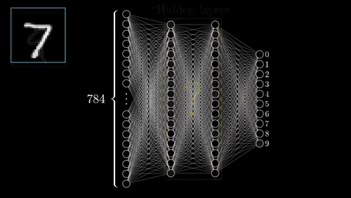
Notes:
How brain registers same response for so many variations of same thing

Slide 5
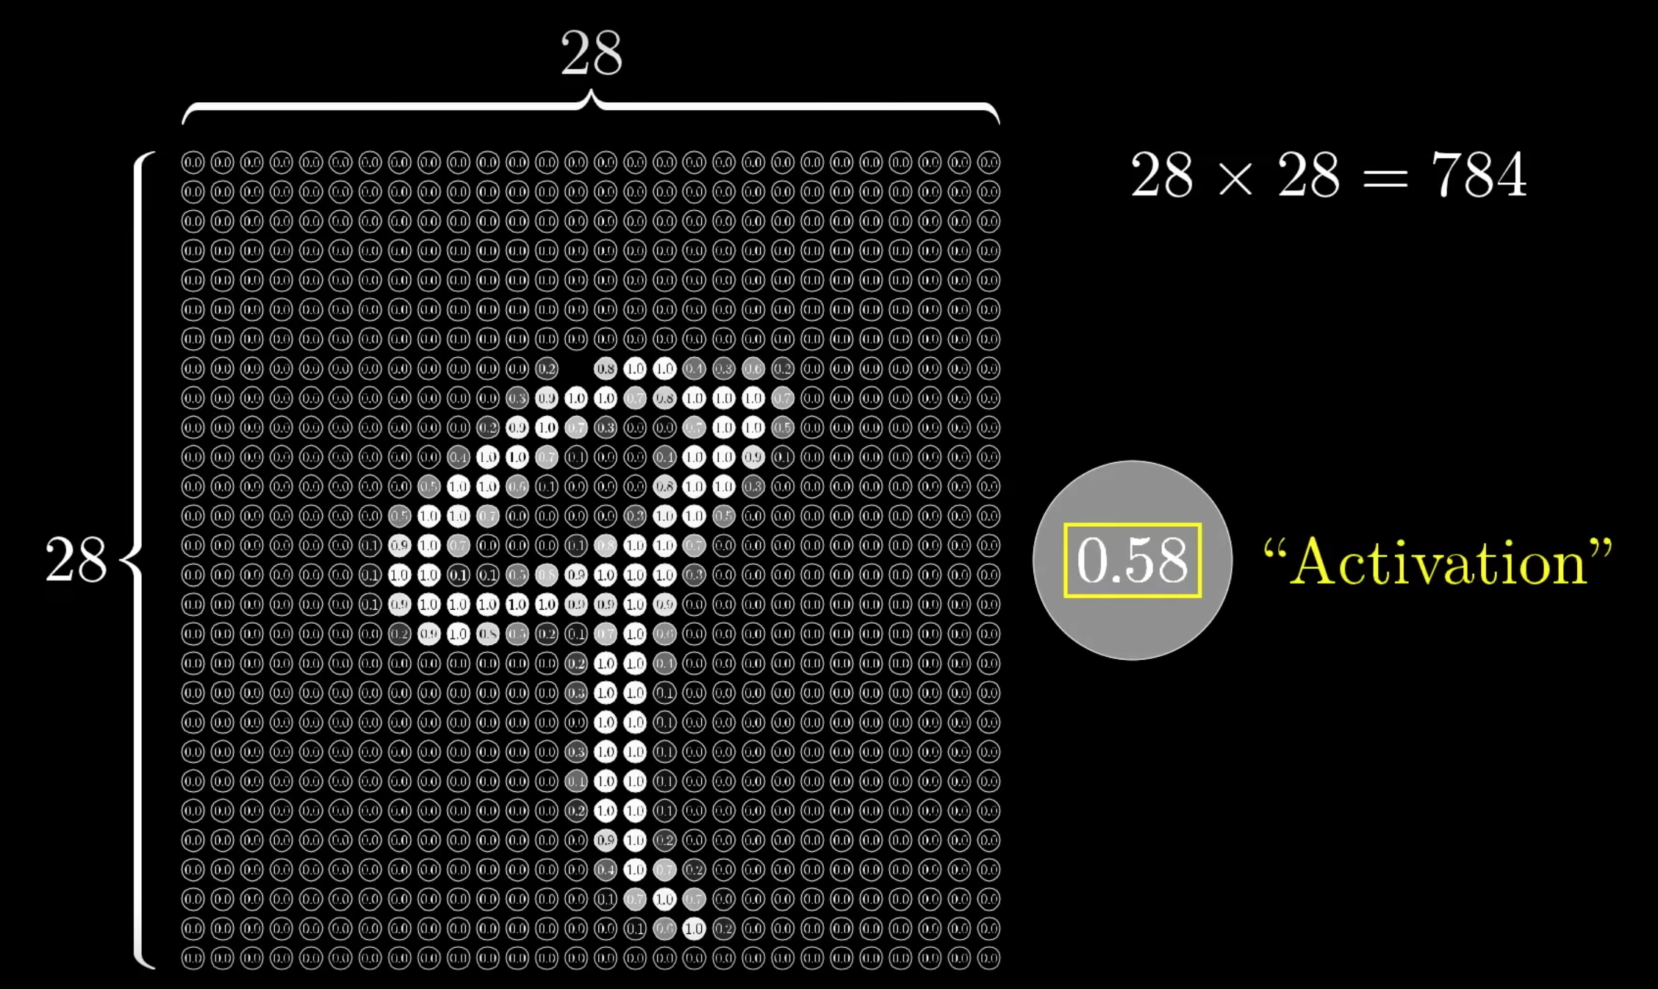

Slide 6
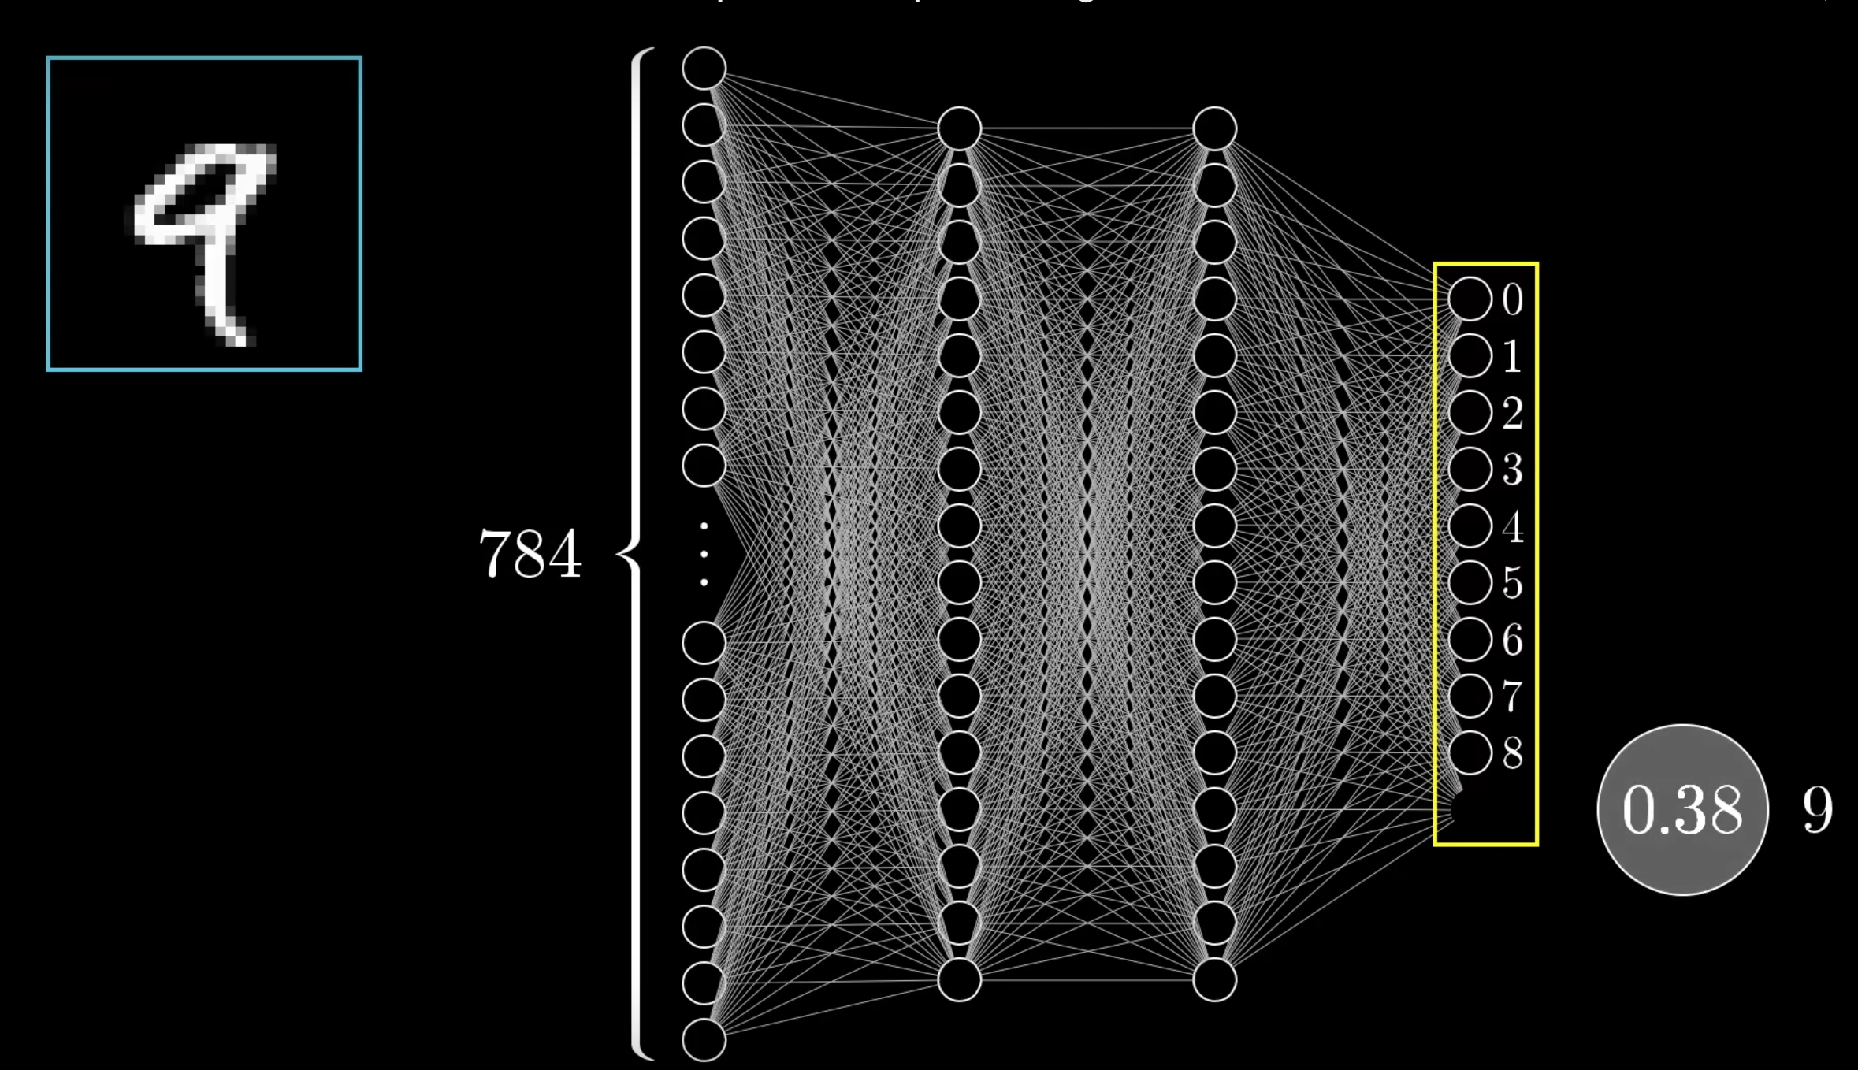

Slide 7
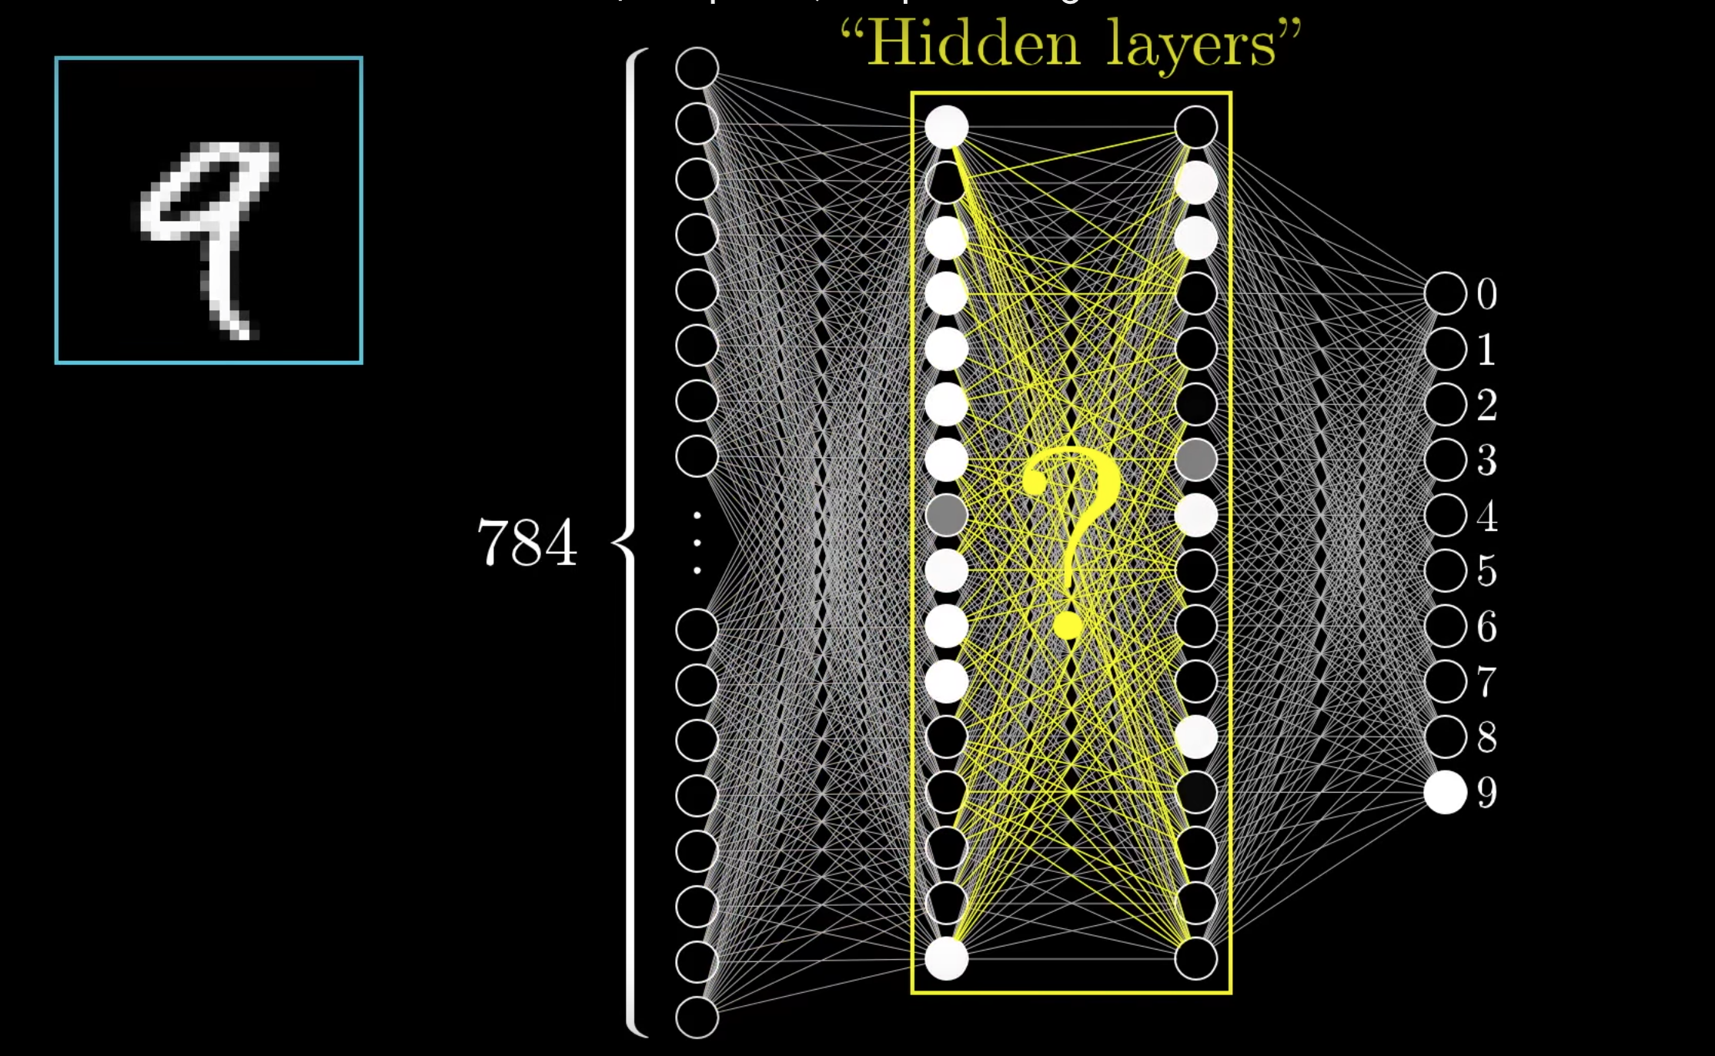

Slide 8
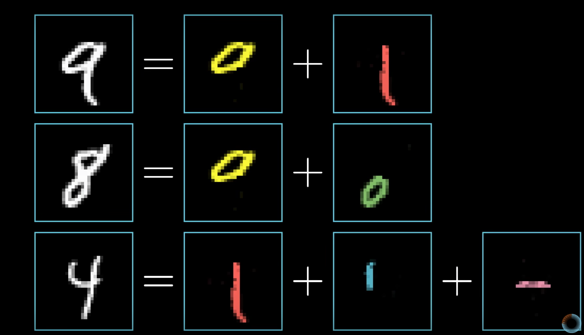

Slide 9
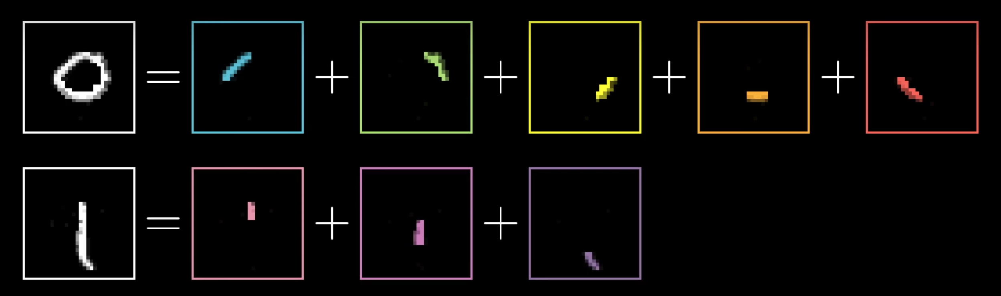

Slide 10
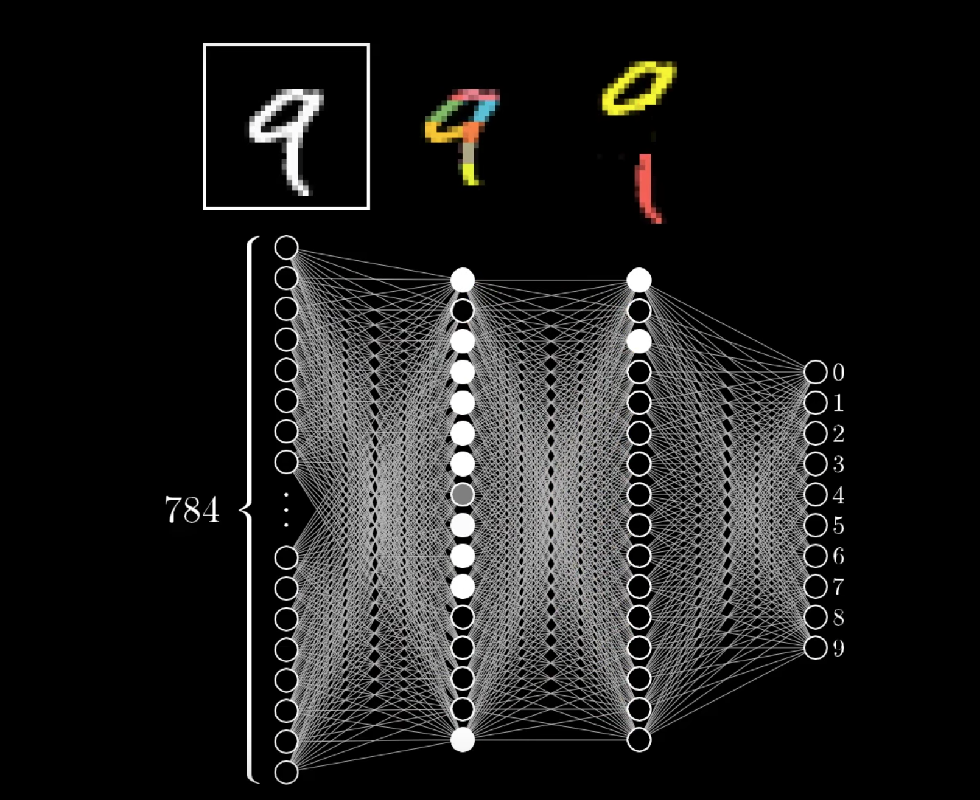

Slide 11
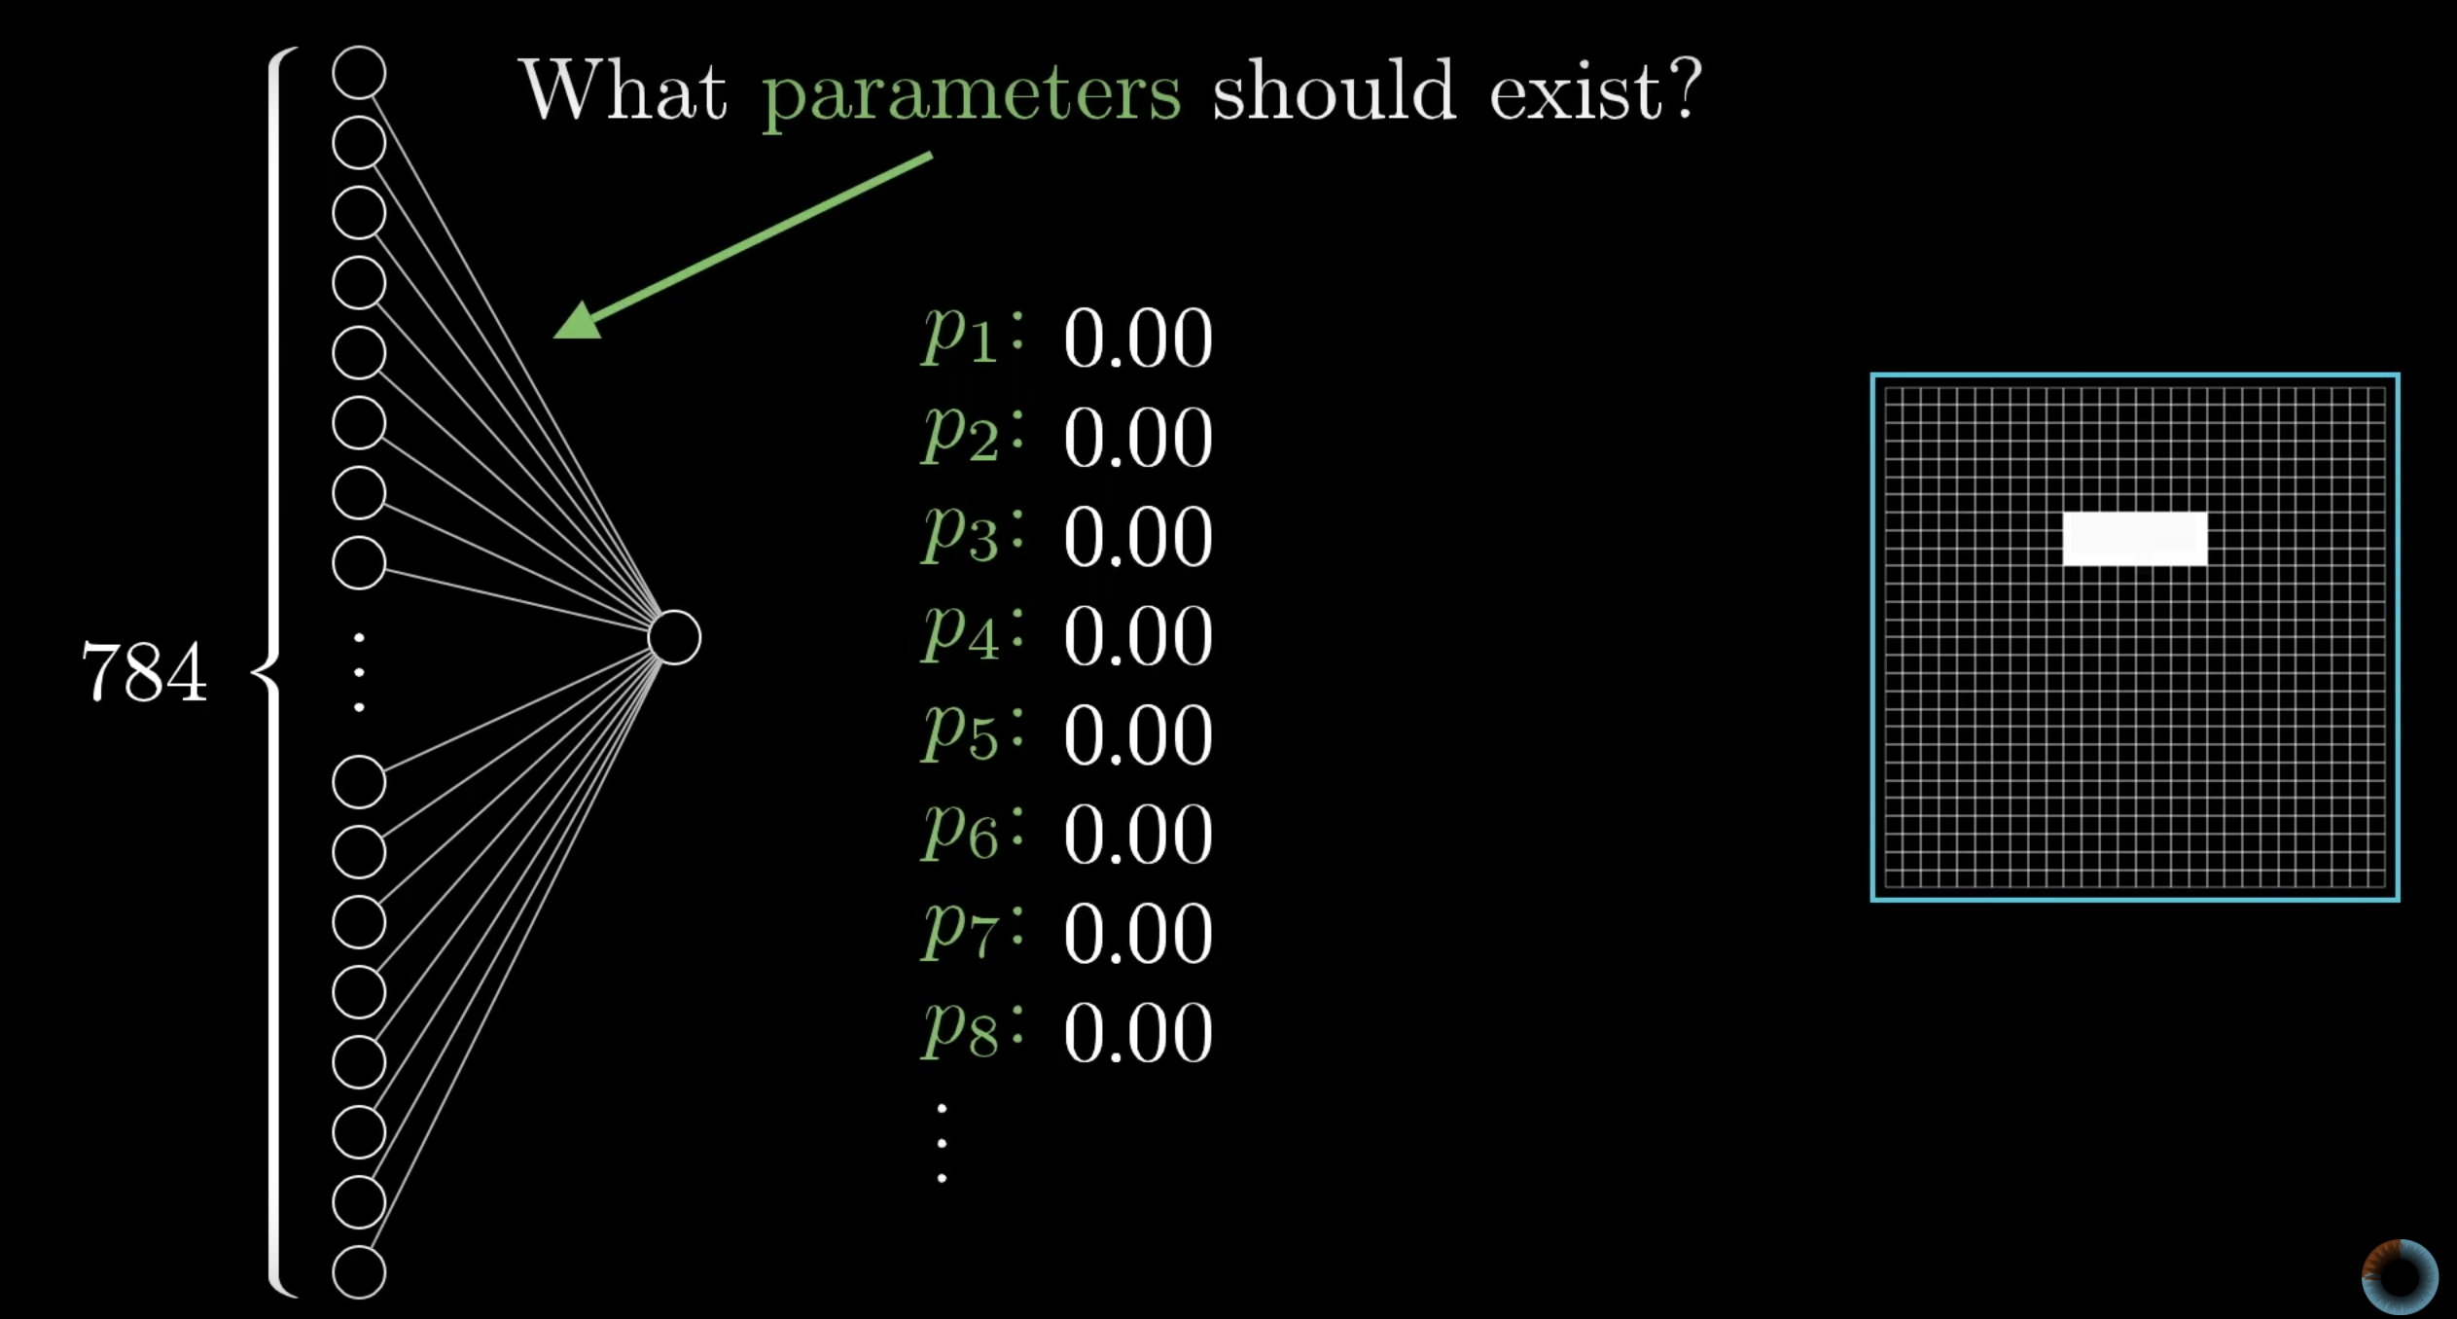

Slide 12
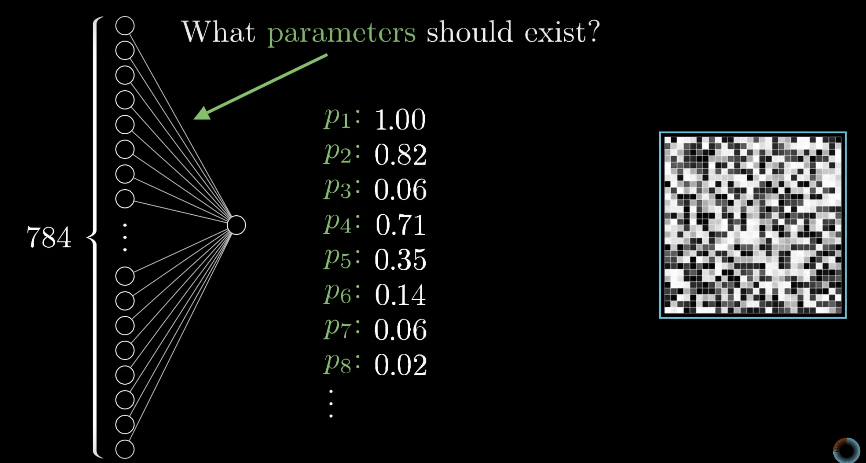

Slide 13
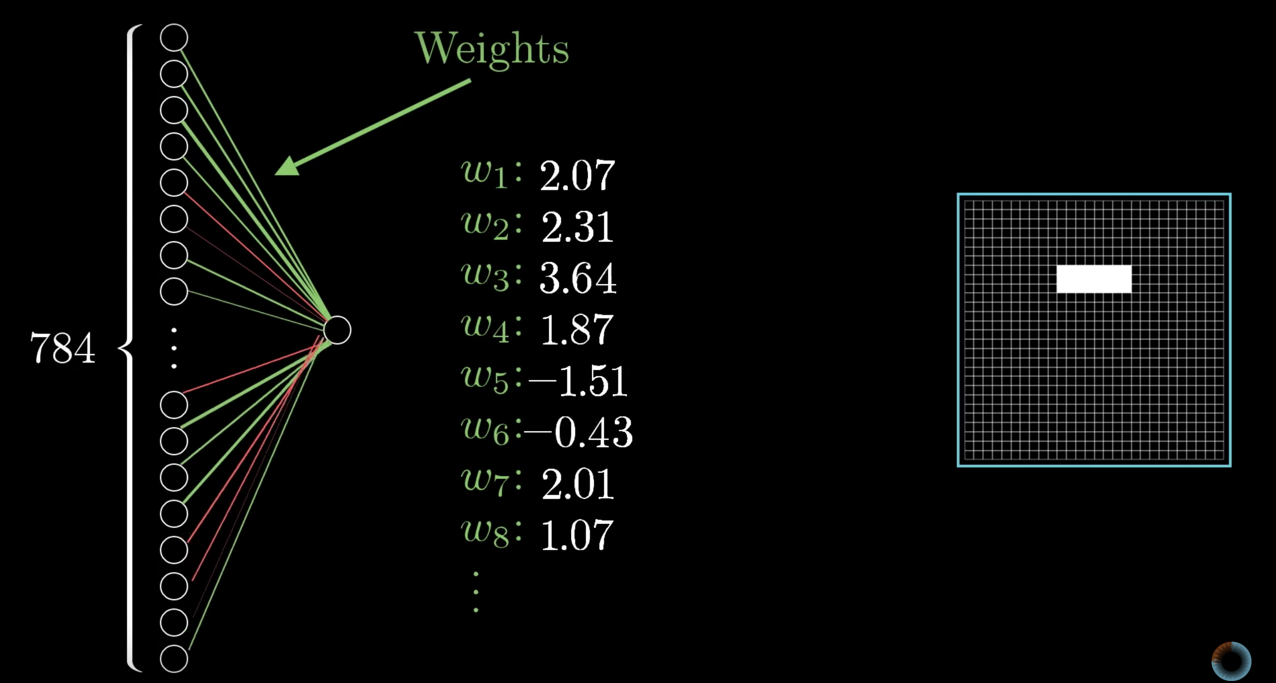

Slide 14
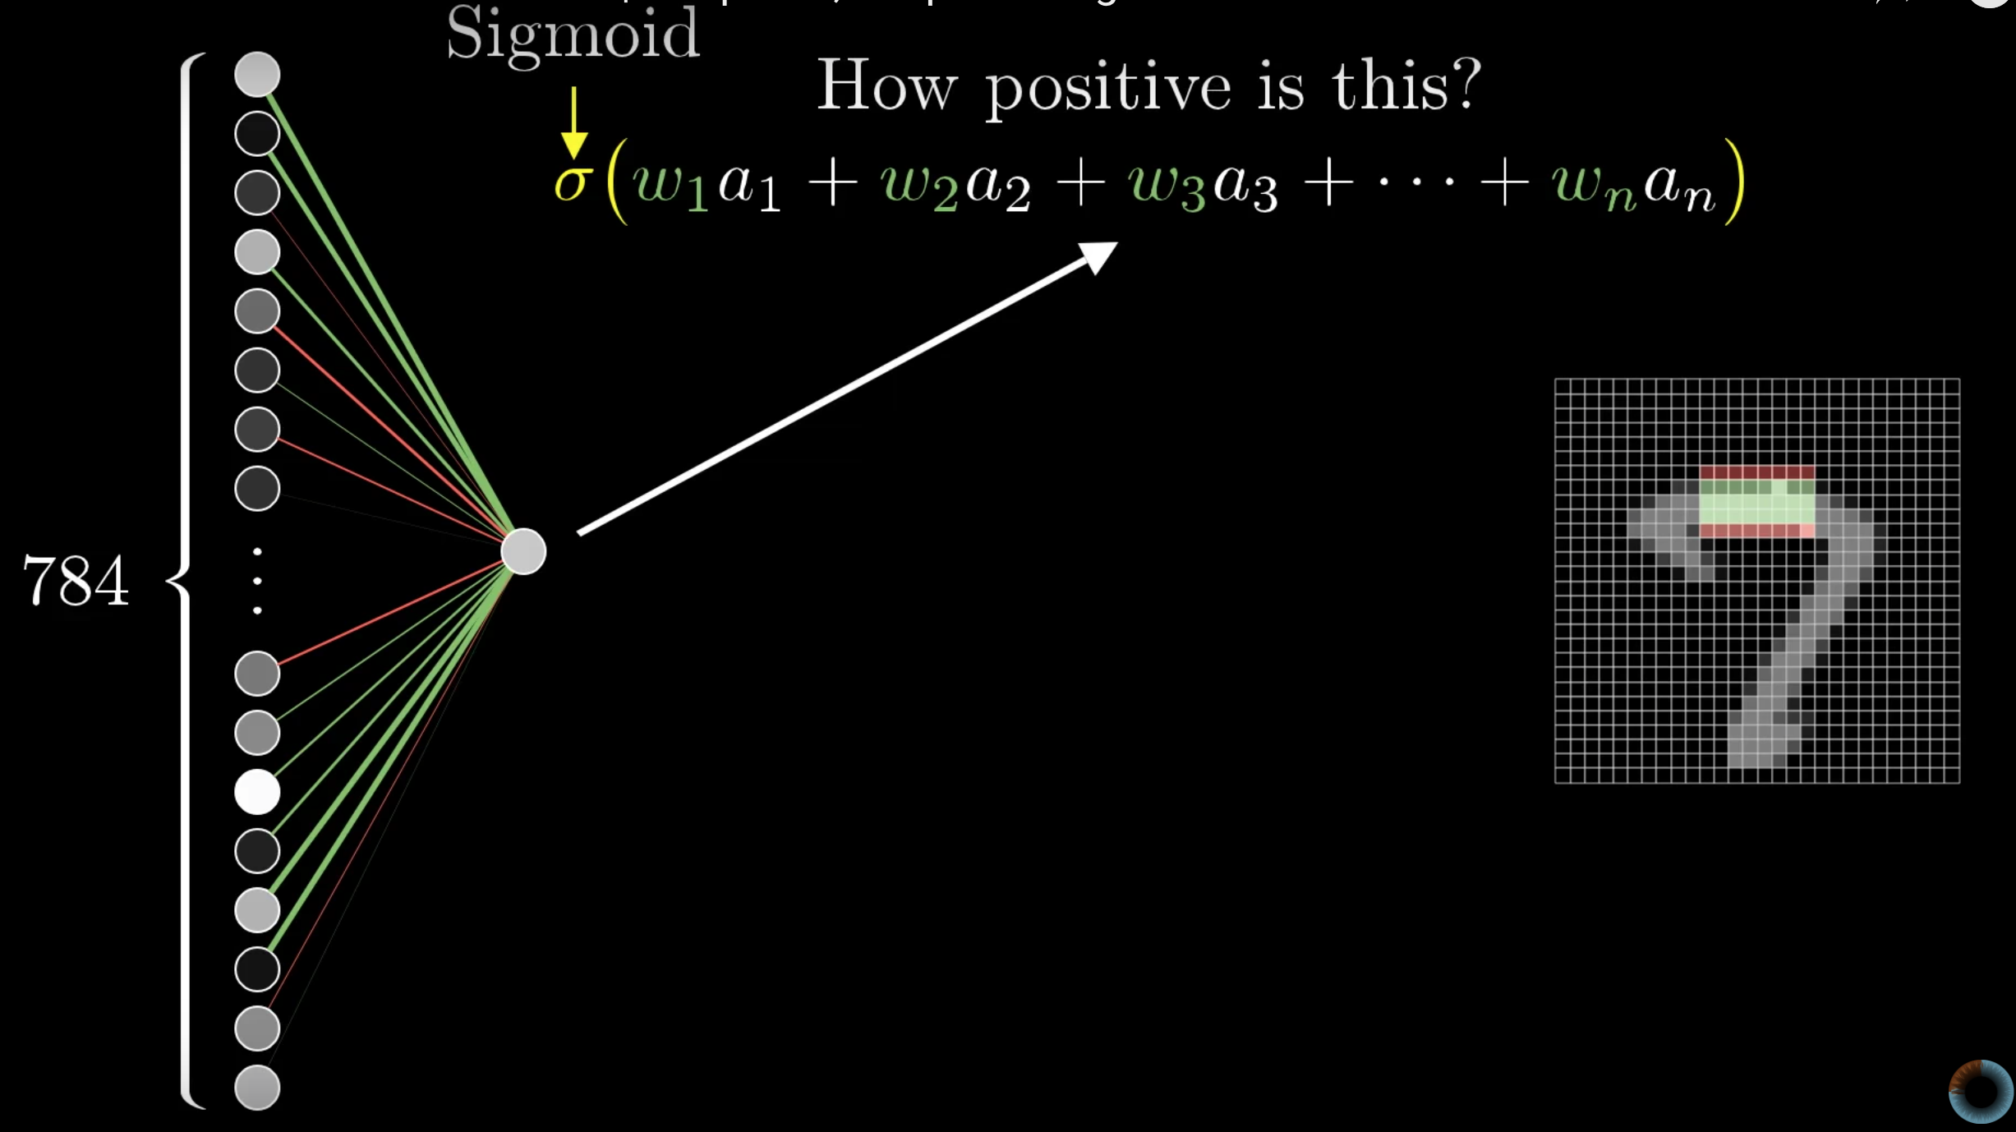
Notes:
Talk about sigmoid

Slide 15
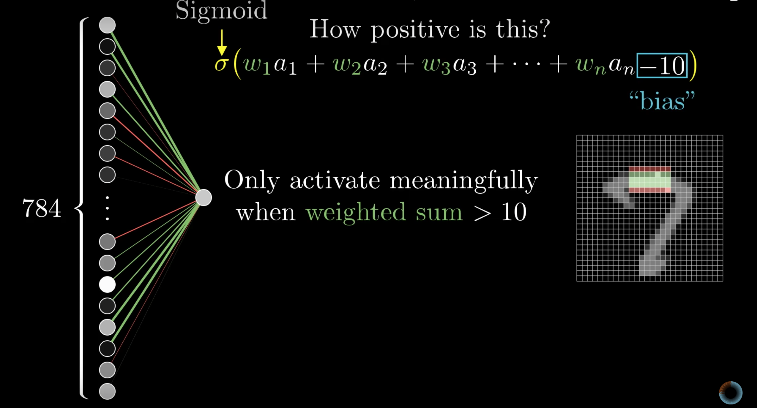
Notes:
Talk about sigmoid

Slide 16
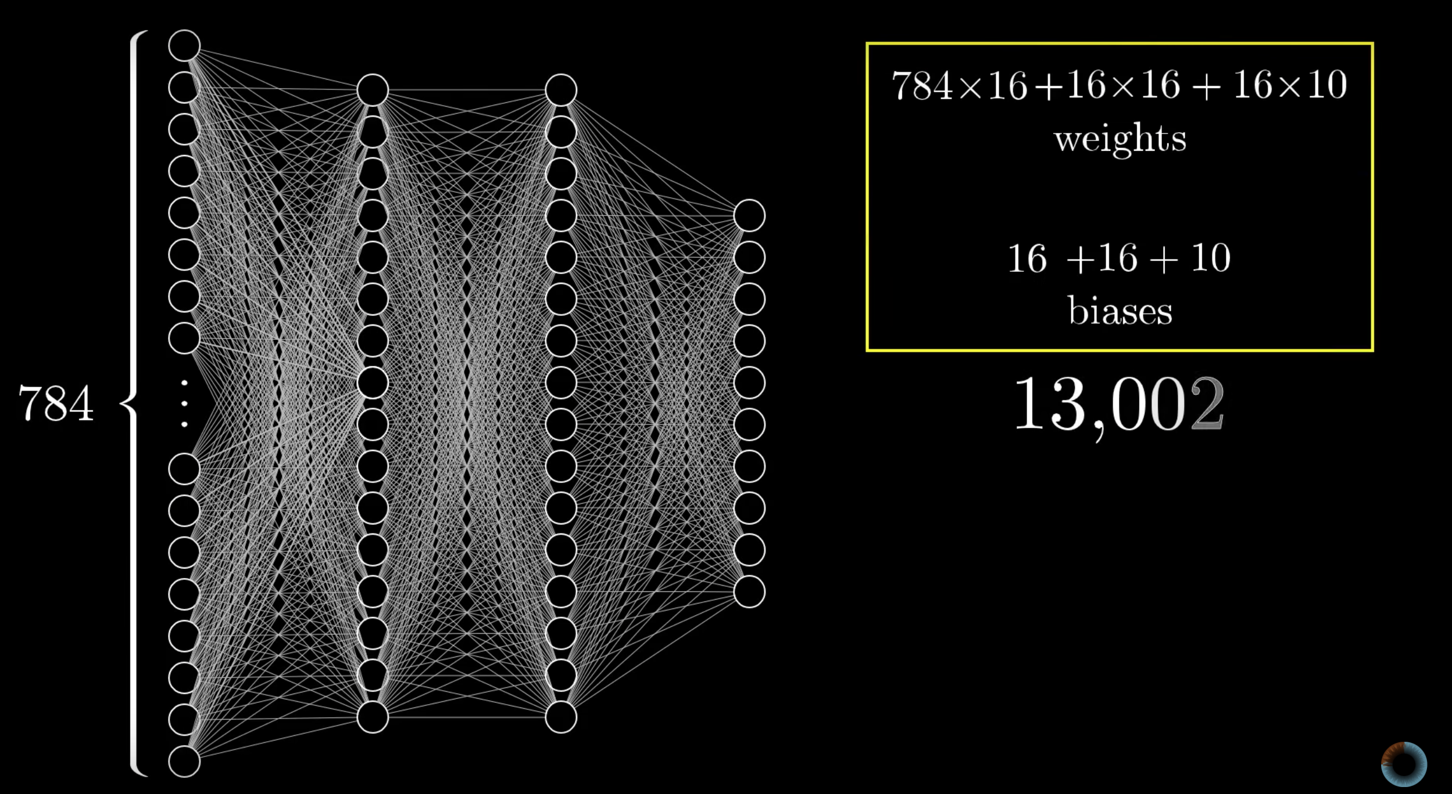
Notes:
Talk about sigmoid

Slide 17
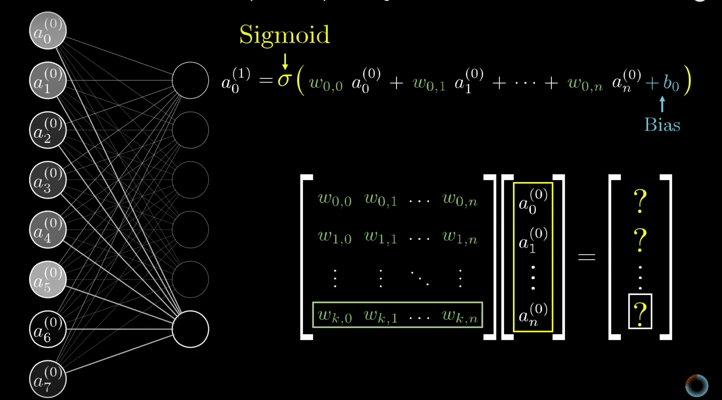
Notes:
Talk about sigmoid

Slide 18
Notes:
Talk about Deep learning as a subset of ML
Computational power difference
Data size difference
Approach difference
Use of ANN
Alpha GO

Slide 19
tensors
Notes:
Explain tensors

Slide 20
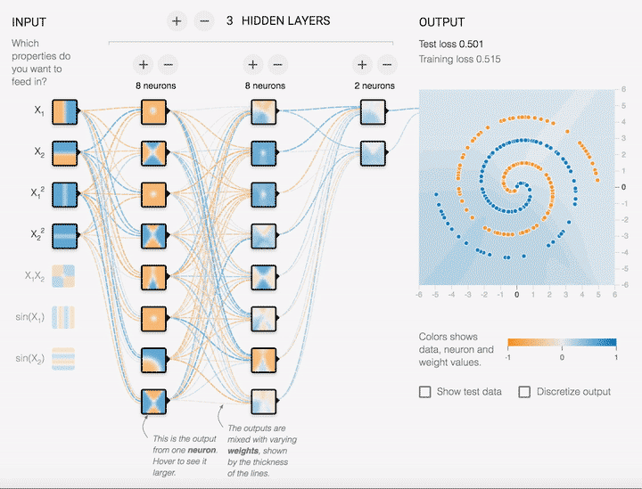

Slide 21
Lets code !

Slide 22
J(w)
Global Cost/Loss Minimum
J_{min}(w)

Slide 23
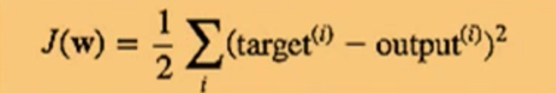
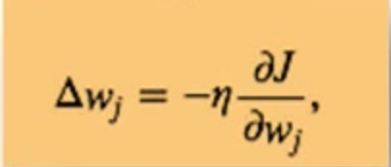
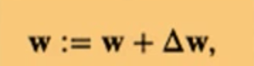
Update weight after each Epoch. The cost function is the sum of squared errors and is written as
The direction of weight update is opposite of the cost gradient
After each epoch weight is updated by the delta

Slide 24
Tensorflow for Poets…more code !

Slide 25
Lets look at it in action !
Notes:
https://youtu.be/-P28LKWTzrI

Slide 26
TPU

Slide 27
Generative adversarial networks (GANs)

Slide 28
Built in original language C/C++
CPU vs GPU vs TPU
Vector proportional to area and perpendicular to area

